Slide 1
Group 2 SENG 6230 Project: Quizard
By:
Alan Master
David Michael Anderson
Bigyan Pandit
Jonathan Eng
Mohammed Sarim Akbar

Slide 2
PMP (Project Management Plan)
Purpose of Project
“Create a working learning management system capable of distributing quizzes to students, collecting student responses to quizzes, generate statistical data on those quizzes and track attendance”
Contents presented in PMP:
Work Activities
Schedule Allocation (Effort Breakdown, Critical Path Diagram, and Gantt Chart)
Iteration Goals
Breakdown of Work Activities

Slide 3
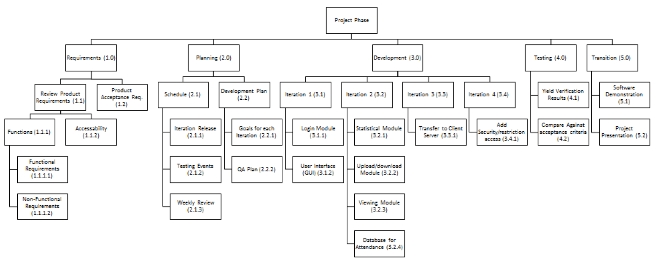
Contents of PMP
Work Activities

Slide 4
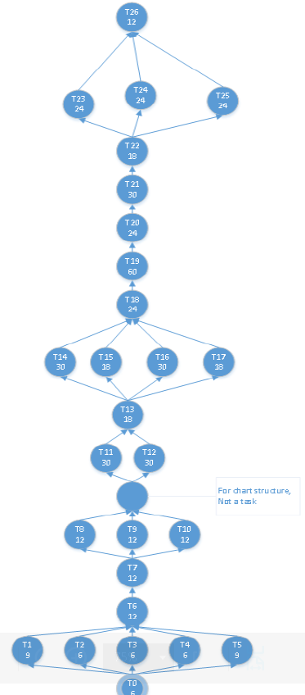
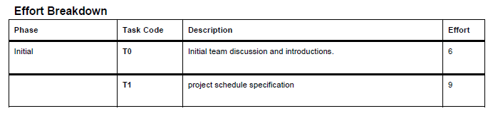
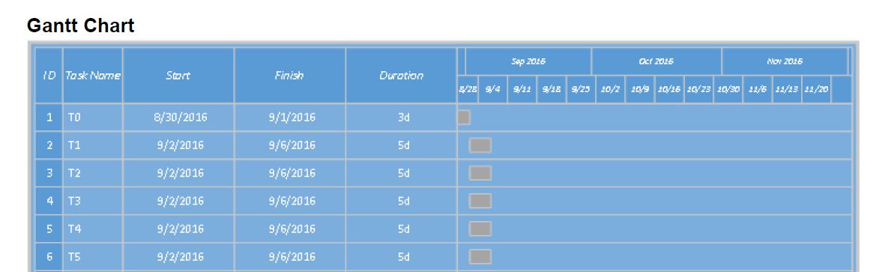
Contents of PMP
Schedule Allocation

Slide 5
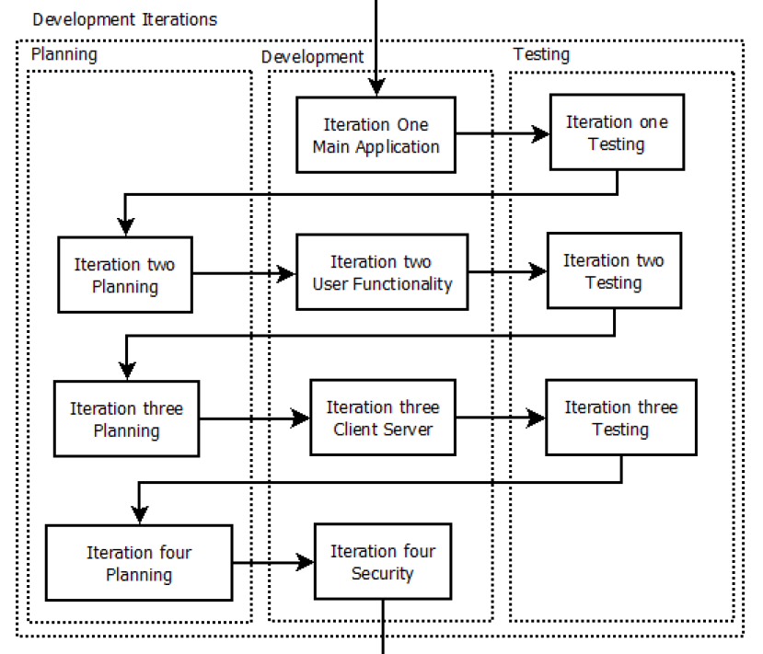
Contents of PMP
Iteration Goals

Slide 6
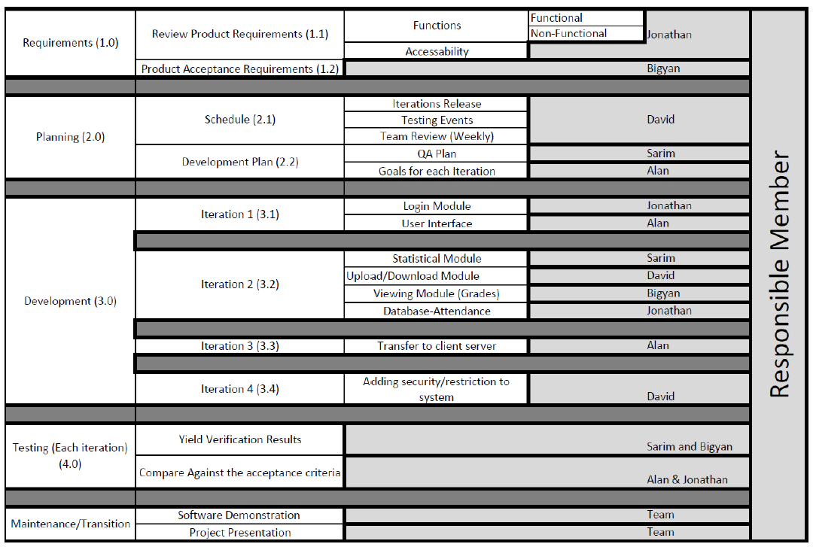
Contents of PMP
Breakdown of Work Activities

Slide 7
SRS (Software Requirements Specifications)
Purpose: “To describe the software system that will be developed for the application.”
Software Requirements, Constraints and Limitations
User Interface
Software Interface
Communication Interface
Operations in the Application
Product Functions
User Characteristics
Constraints
Software System Attributes

Slide 8

Development Tools
Repository: Git Hub
IDE: Visual Studio
Language: C#6
Target platform: Windows 7+
GUI: windows Forms
Database: SqLite
Server: IIS hosted ASP web service

Slide 9
Development Strategies
Code Structure: MVC
Single Instance Controller
Separate projects for application, server and unit tests
Development Model: Incremental
Client-Server interface for multiple users
Server: backend database and session controller
Client: UI interaction

Slide 10
Development Achievements
Iteration one: Early delivery
UI Structure
Iteration two: functioning POC
Detailed database controller
Delivered 31k lines of code
Plans and documents to create a road map from iteration 2 to 4
Missing
Statistical information
Class editing

Slide 11
Black Box Testing
Testing
Functions
Test Cases
Results
Testing reveled our primary weakness was with the upload/download component of the application. Additionally testing discovered lack of functionality in the statistical module of the program as well.

Slide 12

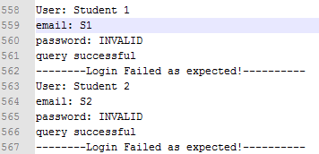
White Box Testing
Example Output
End Results
Findings
White box testing’s failure came from file system checks and maintaining database connectivity. Additionally, it showed a strong backend interface to our database with high reliability for retrieving and linking data. The data was reliably translated into objects, which is the main front end construction of this application.

